Slide 1
What profit is there in serving god?
Sunday service 22 Mar 2020
Cecil ang

Slide 2
Timeline of Israel & judah

Slide 3
Background to malachi
Rebuked the priests for profaning God’s altar and His name; if they were unfaithful in obeying God’s law, how could they lead the people? (1:1-2:9) - breaking the covenant God enacted with Levi (fear of the Lord) - faithless towards God.
Rebuked the people for divorcing their wives and marrying heathen women; how could they lead their children? (2:10-3:15) - breaking the covenant God enacted with their forefathers - faithless towards one another.
Encouraged the faithful few to honour and serve God, whom He would spare when he comes in judgment at Messiah’s returns (3:16-4:6) - the arrogant were saying, “Where’s the God of justice?”

Slide 4
Background to malachi
Literary style – lofty prose not peotry
Each speech begins with a statement charging the people with wrongdoing, then the people objected and demanded clarification, in response the prophet elaborated and reached a conclusion.

Slide 5
Background to malachi
And this second thing you do. You cover the Lord's altar with tears, with weeping and groaning because he no longer regards the offering or accepts it with favor from your hand. ¹⁴ But you say, “Why does he not?” Because the Lord was witness between you and the wife of your youth, to whom you have been faithless, though she is your companion and your wife by covenant. ¹⁵ Did he not make them one, with a portion of the Spirit in their union? And what was the one God seeking? Godly offspring. So guard yourselves in your spirit, and let none of you be faithless to the wife of your youth. (2:13-15)

Slide 6
Mal 3:13-15 ESV
¹³ “Your words have been hard against me, says the Lord. But you say, ‘How have we spoken against you?’
¹⁴ You have said, ‘It is vain to serve God. What is the profit of our keeping his charge or of walking as in mourning before the Lord of hosts?
¹⁵ And now we call the arrogant blessed. Evildoers not only prosper but they put God to the test and they escape.’”

Slide 7
Mal 3:16-18 ESV
¹⁶ Then those who feared the Lord spoke with one another. The Lord paid attention and heard them, and a book of remembrance was written before him of those who feared the Lord and esteemed his name. ¹⁷ “They shall be mine, says the Lord of hosts, in the day when I make up my treasured possession, and I will spare them as a man spares his son who serves him. ¹⁸ Then once more you shall see the distinction between the righteous and the wicked, between one who serves God and one who does not serve him

Slide 8
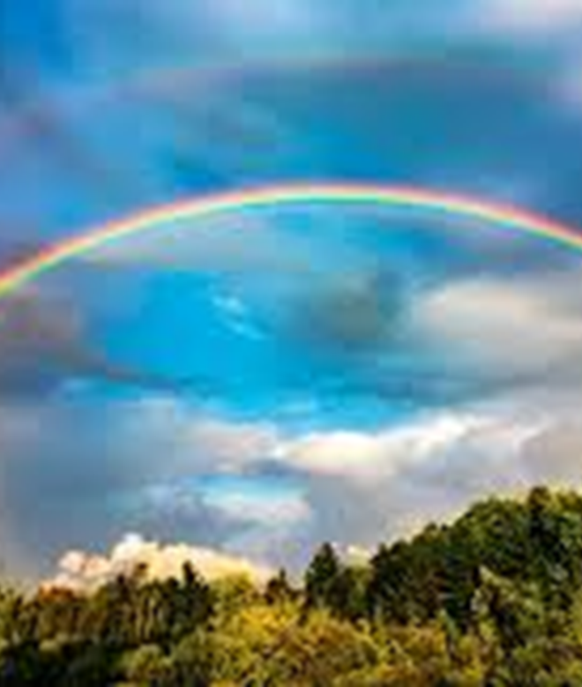
3 Profits in serving god
God remembers - book of remembrance (Mal 3:16)
David’s wanderings in the wilderness when he was being hunted
You have taken account of my wanderings; put my tears in Your bottle. Are they not in Your book? Ps 56:8 NASB
God remembers us when we go through hardships.

Slide 9
3 Profits in serving god
God remembers - book of remembrance (Mal 3:16)
Repentant dying thief on the cross
And he said, “Jesus, remember me when you come into your kingdom.” And he said to him, “Truly, I say to you, today you will be with me in paradise.” Lk 23:42-43 ESV
God remembers us when we are heart-broken.

Slide 10
3 Profits in serving god
God remembers - book of remembrance (Mal 3:16)
Those who depart from iniquity
But God's firm foundation stands, bearing this seal: “The Lord knows those who are his,” and, “Let everyone who names the name of the Lord depart from iniquity.” 2 Tim 2:19 ESV
God remembers us when we pursue holiness.

Slide 11
3 Profits in serving god
God remembers - book of remembrance (Mal 3:16)
³ They (Korah, Dathan & Abiram) assembled themselves together against Moses and against Aaron and said to them, “You have gone too far! For all in the congregation are holy, every one of them, and the Lord is among them. Why then do you exalt yourselves above the assembly of the Lord?” ⁴ When Moses heard it, he fell on his face, ⁵ and he said to Korah and all his company, “In the morning the Lord will show who is his, and who is holy, and will bring him near to him. The one whom he chooses he will bring near to him. Num 16:3-5 ESV

Slide 12
3 Profits in serving god
God remembers - book of remembrance (Mal 3:16)
²⁵ Then Moses rose and went to Dathan and Abiram, and the elders of Israel followed him. ²⁶ And he spoke to the congregation, saying, “Depart, please, from the tents of these wicked men, and touch nothing of theirs, lest you be swept away with all their sins.”
⁴⁶ And Moses said to Aaron, “Take your censer, and put fire on it from off the altar and lay incense on it and carry it quickly to the congregation and make atonement for them, for wrath has gone out from the Lord; the plague has begun.” ⁴⁷ So Aaron … put on the incense and made atonement for the people. ⁴⁸ And he stood between the dead and the living, and the plague was stopped. Num 16:25-26, 46-48 ESV

Slide 13
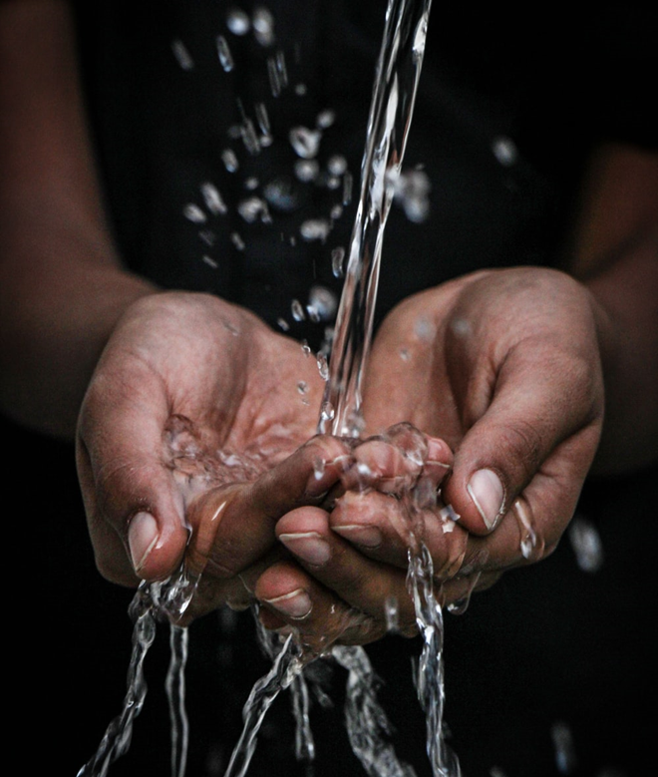
3 Profits in serving god
God responds – paid attention & heard them (Mal 3:16)
To God-fearers
The Lord is near to all who call on him, to all who call on him in truth. He fulfills the desire of those who fear him; he also hears their cry and saves them. Ps 145:18-19 ESV
The fear of the Lord is hatred of evil. Pride and arrogance and the way of evil and perverted speech I hate. Pr 8:13 ESV

Slide 14
3 Profits in serving god
God responds – paid attention & heard them (Mal 3:16)
To Noah’s faith to build an ark
By faith Noah, being warned by God concerning events as yet unseen, in reverent fear constructed an ark for the saving of his household. By this he condemned the world and became an heir of the righteousness that comes by faith. Heb 11:7 ESV
But God remembered Noah and all the beasts and all the livestock that were with him in the ark. And God made a wind blow over the earth, and the waters subsided. Gen 8:1 ESV

Slide 15
3 Profits in serving god
God responds – paid attention & heard them (Mal 3:16)
To Abraham’s intercession
So the men turned from there and went toward Sodom, but Abraham still stood before the Lord. Then Abraham drew near and said, “Will you indeed sweep away the righteous with the wicked? Gen 18:22-23 ESV
So it was that, when God destroyed the cities of the valley, God remembered Abraham and sent Lot out of the midst of the overthrow when he overthrew the cities in which Lot had lived. Gen 19:29 ESV

Slide 16
3 Profits in serving god
God rescues
His faithful servants
“They shall be mine, says the Lord of hosts, in the day when I make up my treasured possession, and I will spare them as a man spares his son who serves him.” Mal 3:17 ESV

Slide 17
3 Profits in serving god
God rescues
From fiery judgment to come
“For behold, the day is coming, burning like an oven, when all the arrogant and all evildoers will be stubble. The day that is coming shall set them ablaze, says the Lord of hosts, so that it will leave them neither root nor branch. Mal 4:1 ESV
And if anyone's name was not found written in the book of life, he was thrown into the lake of fire. Rev 20:15 ESV

Slide 18
3 Profits in serving god
God rescues
From ferocious enemies
² But for you who fear my name, the sun of righteousness shall rise with healing in its wings. You shall go out leaping like calves from the stall. ³ And you shall tread down the wicked, for they will be ashes under the soles of your feet, on the day when I act, says the Lord of hosts. Mal 4:2-3 ESV
The God of peace will soon crush Satan under your feet. The grace of our Lord Jesus Christ be with you. Rom 16:20 ESV

Slide 19
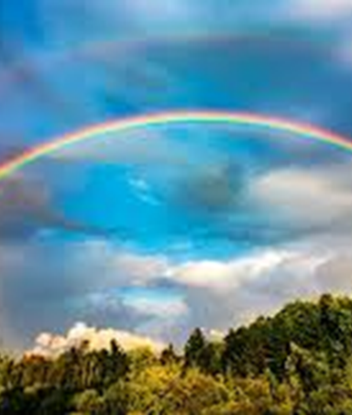
Conclusion
God Remembers | Hardships Heart-brokenness Holiness
God Responds | God-fearers Faith Intercession
God Rescues | Faithful servants Fiery judgment Ferocious enemies
Then once more you shall see the distinction between the righteous and the wicked, between one who serves God and one who does not serve him. Mal 3:18 ESV

